Slide 1
Live Demo : AngularJS Trending Features
View AngularJS course details at www.edureka.co/angular-js
For Queries during the session and class recording:
Post on Twitter @edurekaIN: #askEdureka
Post on Facebook /edurekaIN
For more details please contact us:
US : 1800 275 9730 (toll free)
INDIA : +91 88808 62004
Email us : sales@edureka.co

Slide 2
Objectives
At the end of this module, you will be able to understand:
Controllers
Two Way Data Binding
Custom Directives and Filters
Unit Testing in AngularJS
AngularJS with Node.js
Notes:
PRD layout, Understanding it's basic features, designing basic report containing graphical chart, Conditional Formatting, studying the PRPT file format, building a basic report in PDF report

Slide 3
Controllers
Controllers in AngularJS define the workflow presentation logic
A JavaScript object
Created by a standard JavaScript object constructor
Attached to the view with ng-controller
Controllers can be defined in the application as shown
Defining Controller
var myApp = angular.module('myApp',[]);
myApp.controller(‘MyController'.......
Using Controller in application
<div ng-controller=“MyController">
<body ng-controller=“MyController">

Slide 4
Scopes
Injected as an argument to the controller function
Holds the model data required by the view
Binds data to the view using AngularJS two way data binding
Represented by $scope in the controller function and links the controller to the view
Figure shown is representation of scope
app.controller(‘MyController', ['$scope', function($scope) {
…………………..
]};
}]);

Slide 5
Model and Template
MODEL
AngularJS is a model driven application
A Model encapsulates the application data
Any change in the state, provides appropriate notifications to the controller and views
On notification views updates the output display of the application
Updating of view happens automatically with data bindings
TEMPLATE
Represents the model in the view and user interactions with application

Slide 6


Putting Everything Together
How to bring relation between Model, Controller and Templates in the application?

Slide 7
Controller Structure
Controller
Scope Injection
app.controller('ProductsController', ['$scope', function($scope) {
$scope.product = {
id: 1,
name: 'Smart Phones‘,
type: ‘Mobile‘,
stores: [
{ id: 1, name: 'Samsung Galaxy', quantity: 5},
{ id: 2, name: 'Nokia', quantity: 3},
{ id: 3, name: 'HTC', quantity: 6}
]
};
}]);
Model

Slide 8
Two Way Data Binding
Controller
Model
<div ng-controller="ProductController">
Id: <span ng-bind="product.id"></span>
<br/>
Name:<input type="text" ng-model="product.name" />
<br/>
Category: <input type="text" ng-model="product.type" />
</div>
AngularJS Binding
Model Attribute
Binds form control to property

Slide 9
DEMO
Controllers

Slide 10
DEMO
Two Way Data Binding

Slide 11
Why Custom Directives?
If AngularJS comes up with wide rich variety of directives, why it is required to create custom directive?

Slide 12
Need of Custom Directives
AngularJS comes with a lot of built-in directives which can successfully manipulate the DOM elements and perform data binding much more...
But at certain times like converting collection into grid and display in view breaks separation of concerns, so it is necessary to create directives as an element or attribute etc. This module will focus on the guidelines of creating the custom directives

Slide 13
Custom Directive Usage
For a module “MyAppModule” a directive with restrict option will be done in the following way
Module Definition
angular.module(MyModule', [])
.directive(‘myDirective', function () {
return {
restrict: 'A',
link: function (scope, elem, attrs) {
}
}
Directive Definition
Restrict Option

Slide 14
DEMO
Creating Custom Directive

Slide 15
Why Custom Filters
If AngularJS comes up with wide rich variety of filters, why it is required to create custom filters?

Slide 16
Need of Custom Filters
AngularJS comes with a lot of in-built filters which helps to build applications faster and easier. But there are some scenarios like in case of Angular currency filter, we need the denominations to be displayed differently than the built-in functionality. In scenarios like these we need to develop custom filters

Slide 17
Custom Filter Structure
AngularJS comes with elegant way of creating Filters
Integrating filters to the current application is lot easier by using the below syntax
app.filter(‘filterName', function() {
return function(input, option1, option2) {
var out;
//function code
return out;
});

Slide 18
DEMO
CUSTOM FILTERS

Slide 19

Unit Testing

Slide 20
Manual Testing
Traditionally developers manually test their application
Manual testing is less efficient
Very difficult to track the test result
Very difficult to test all the pieces of code
Very difficult to test the integration of two ore more functions
Differs from one developer to another developer

Slide 21
Unit Testing With Angular.js
Add Test
Refactor
Watch
Test Fail
Watch
Code
Run Test

Slide 22
DEMO
Unit Test

Slide 23
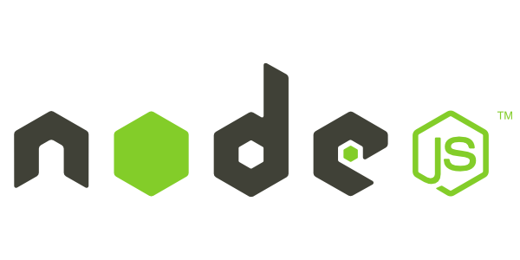

Node.js
Node.js is an open source JavaScript runtime environment to develop server side applications
Node.js runs on V8 JavaScript Engine, V8 is written in C++
C++

Slide 24
Why Node.js ?
Why it is required to run an application in JavaScript server environment like Node.js ?

Slide 25
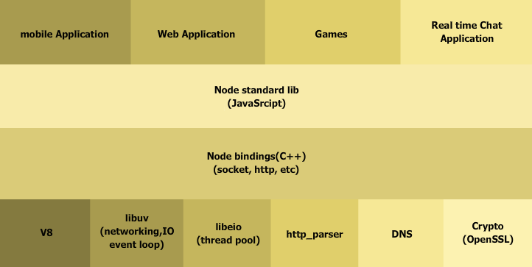
Node.js Architecture

Slide 26




Who uses Node.js?

Slide 27
DEMO
Node.js with Angular

Slide 28
Course Features

Slide 29
Course Topics
Module 1
Introduction to JavaScript MVC Framework and AngularJS
Module 2
Dependency Injection and Controllers
Module 3
Route, Directive and Filters
Module 4
Creating Custom Directives and Filters
Module 5
Third-party AngularJS Modules and Testing Angular
Module 6
AngularJS with Node.js, Yeoman and Rest Exposure
Module 7
Project Discussion

Slide 30
Exclusive Offer
“Buy AngularJS and get Node.js Course free”
To avail this offer please contact us:
US : 1800 275 9730 (toll free)
INDIA : +91 88808 62004
Email Us : sales@edureka.co

